Slide 1
S.C.A.R.A.N - The Robotic Arm
ASAP Robotics Project
TEAM 3000

Slide 2
TEAM MEMBERS
CICY K AGNES
MOHAMMAD SAIF
ANAGHA P
AROMAL O K
RUGMINI
NIPUN RAJ

Slide 3
DESCRIPTION :
SCARAN is simple robotic arm which can be used for lifting light weighted objects and placing it
DOF = 5
Material made of : plastic ( 3D printed )
Mechanics : 3 Servo (MG996R) and 3 (SG90)micro Servo motors
Micrcontroller : Arduino UNO R3
Controlled through : Serial monitor of Arduino IDE from computer connected
Communicating Baud Rate : 9600

Slide 4
SCARAN Components :
MG996R Servo Motors x 3
SG90 Micro Servo Motor x 3
Arduino Uno R3 microcontroller x 1
Jumper Wires
3D printed parts

Slide 5
MAIN STEPS INVOLVED
Circuit designing
Coding
3D design
Combining motors and 3D printed parts
Conecting the SCARAN with Arduino and uploading Code
Debugging and checking functionality

Slide 6
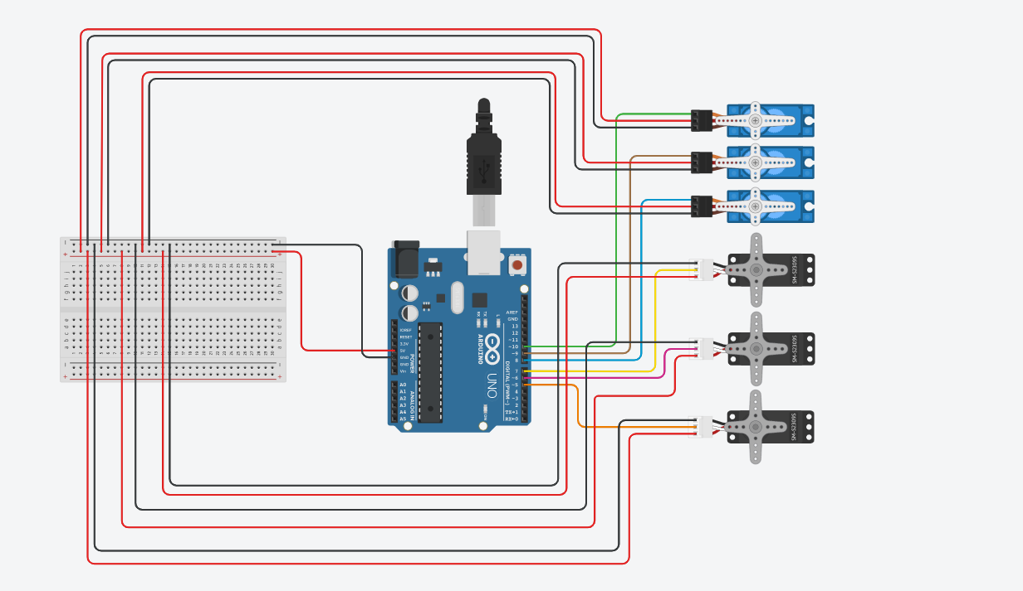
Circuit Designing :
SERVO 6
SERVO 5
SERVO 4
SERVO 3
SERVO 2
SERVO 1

Slide 7
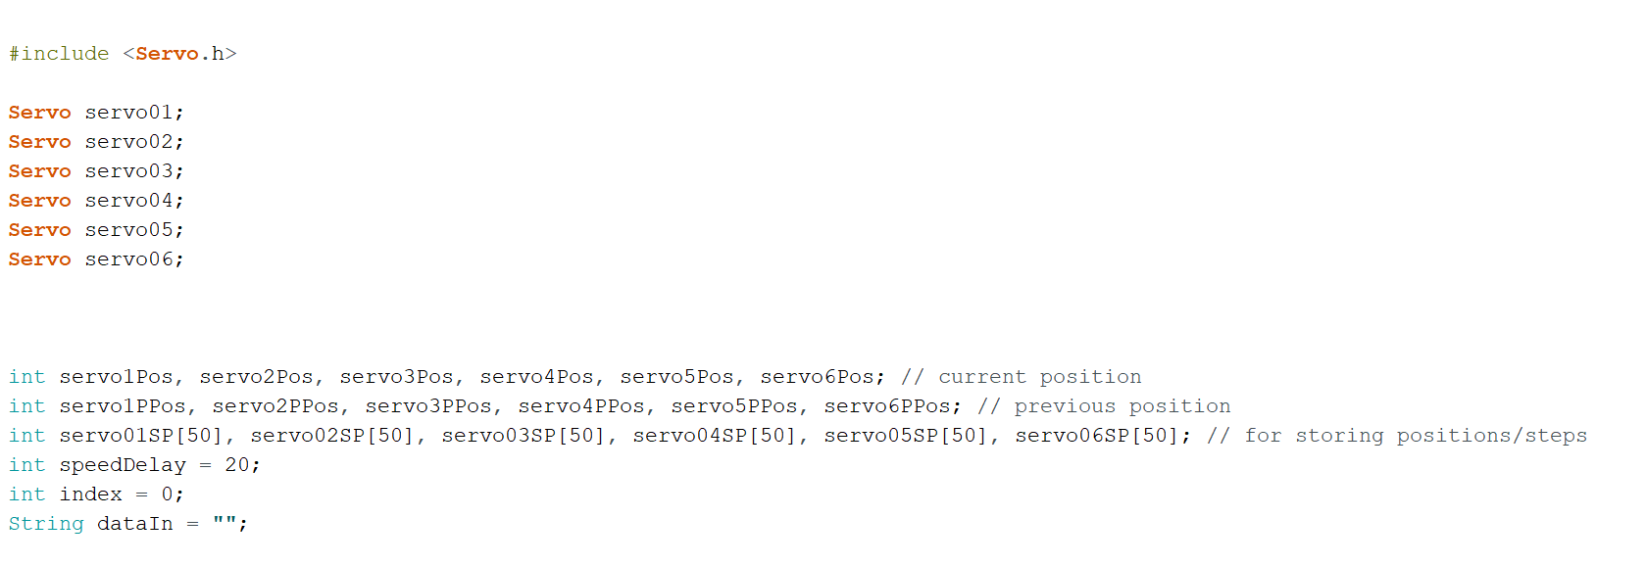
Code :
Link for Arduino Code : https://drive.google.com/file/d/1kHbsmPfCC8yjhyvyJ8UXbEvDiqVwHR-P/view?usp=sharing

Slide 8
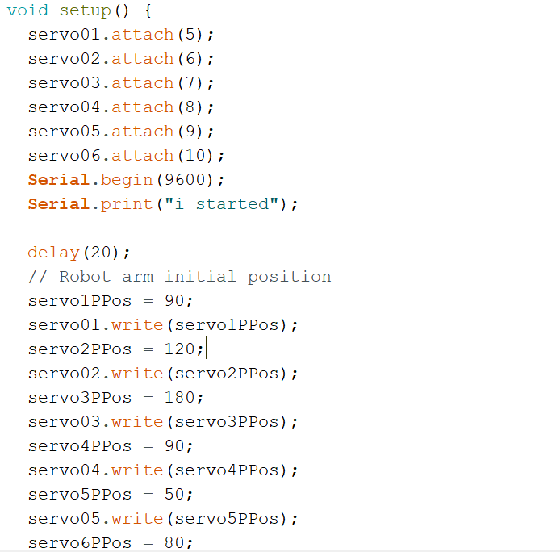

Slide 9
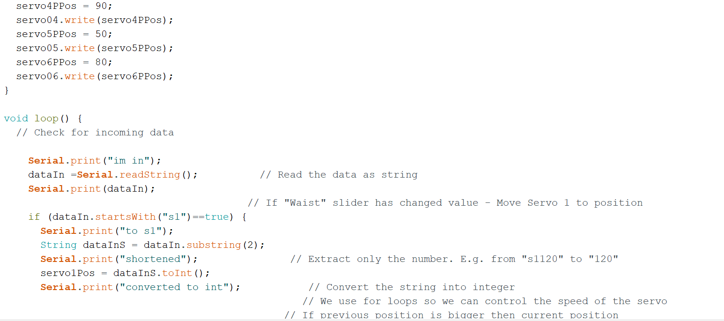

Slide 10
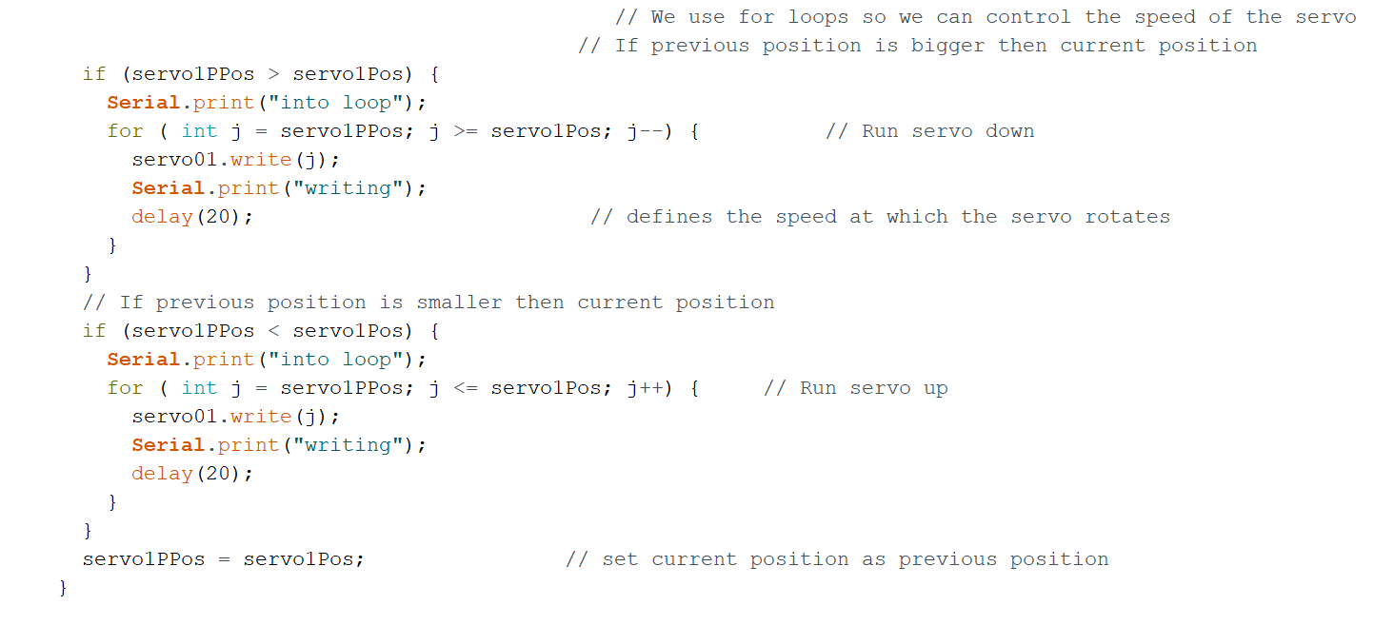

Slide 11
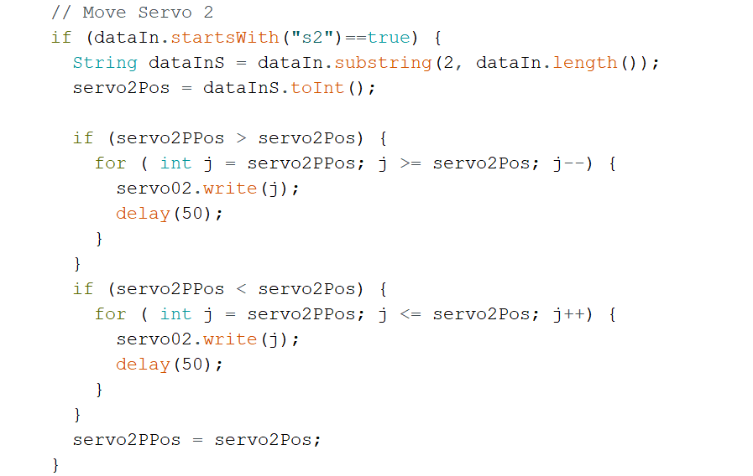

Slide 12
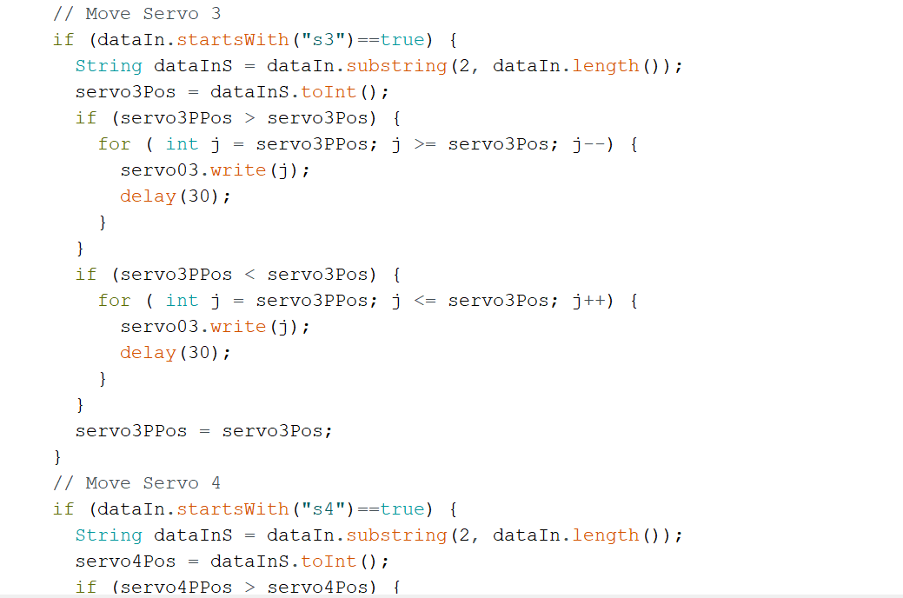

Slide 13
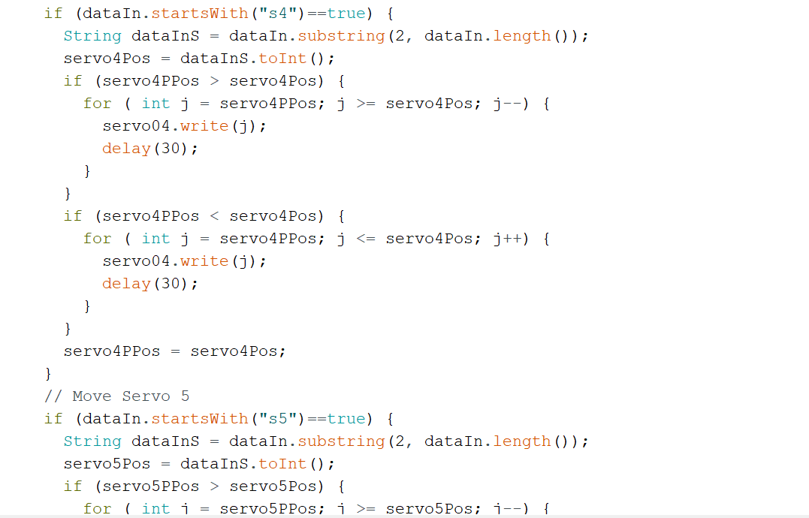

Slide 14
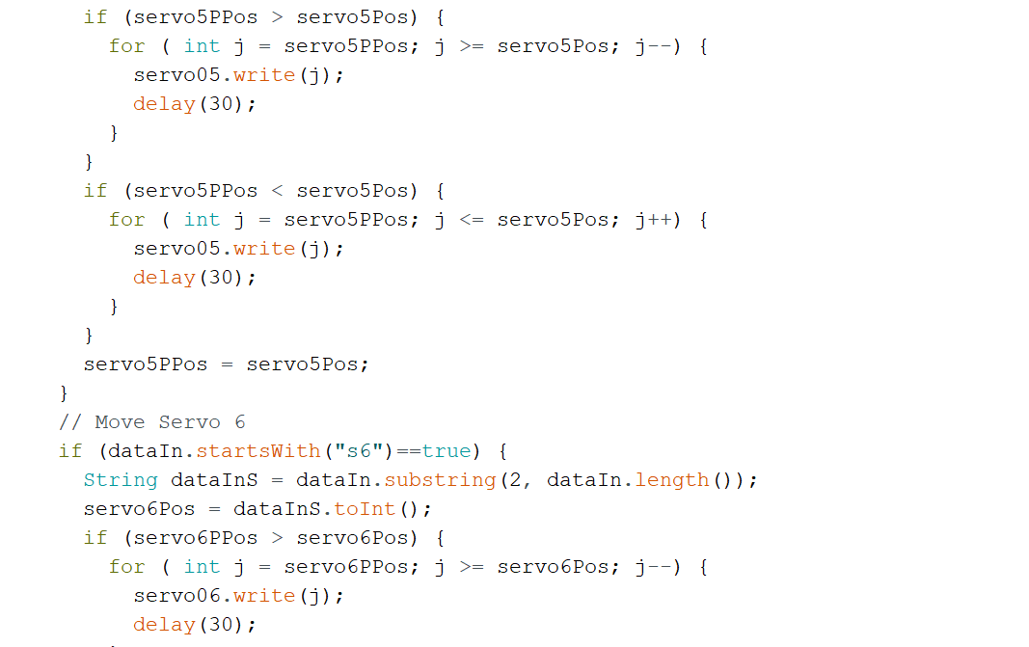

Slide 15
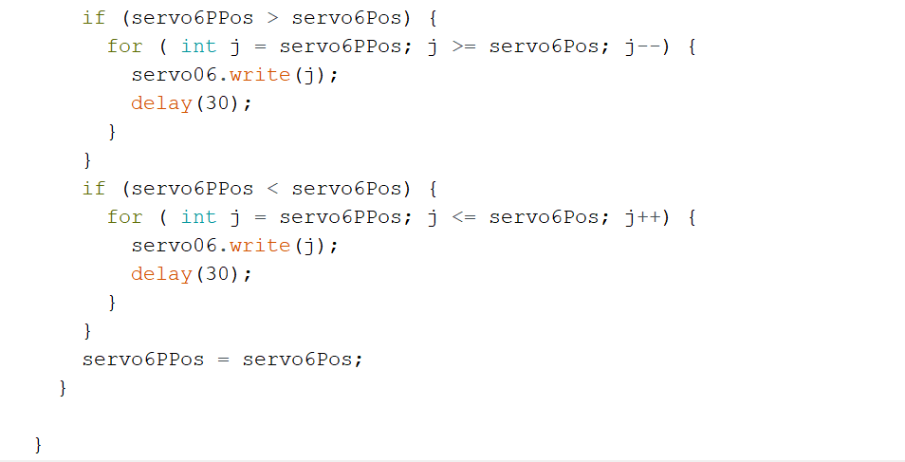

Slide 16
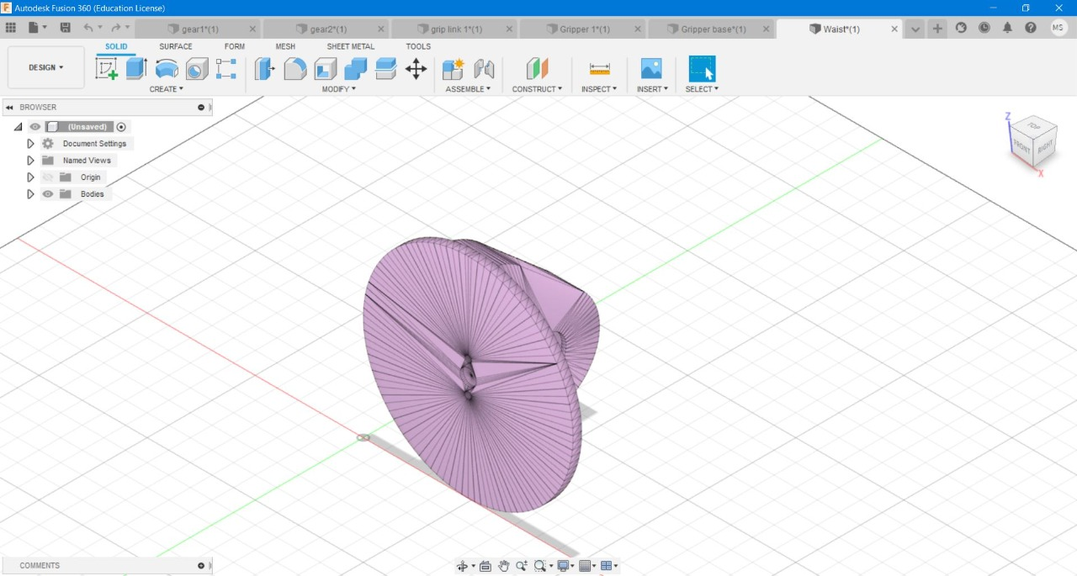
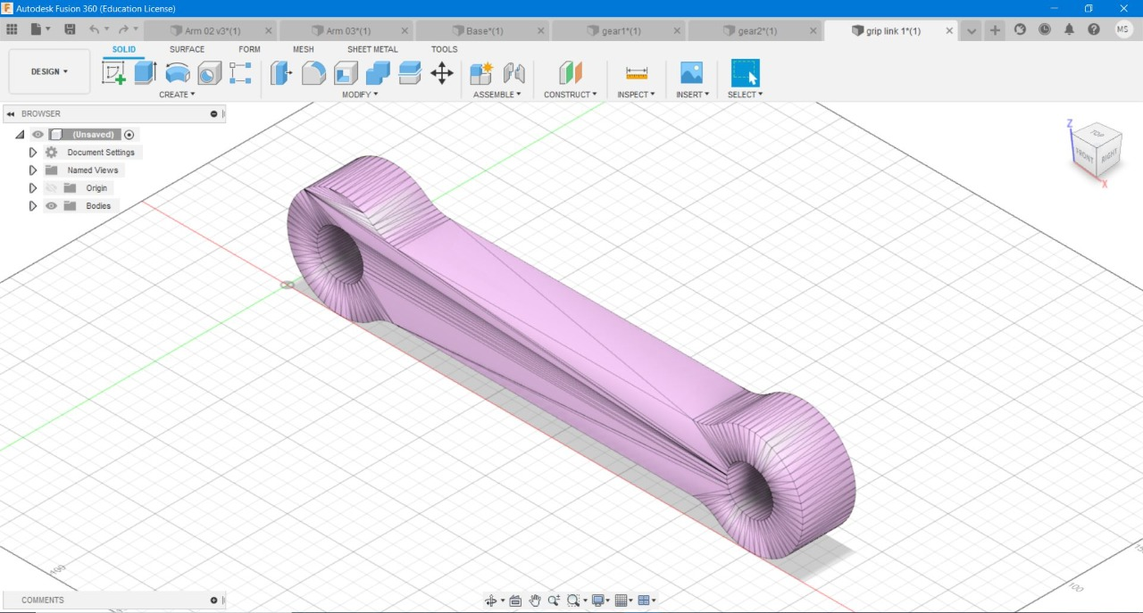
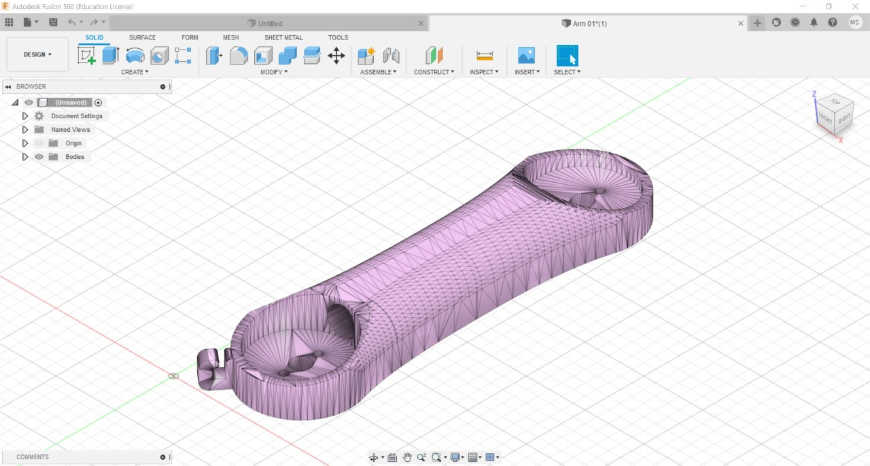
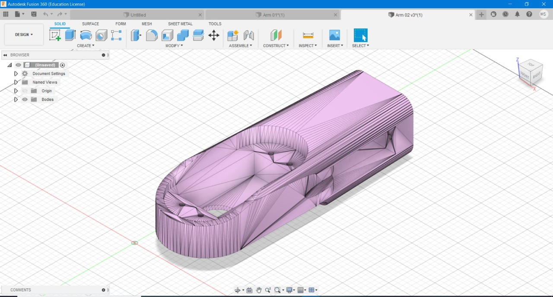
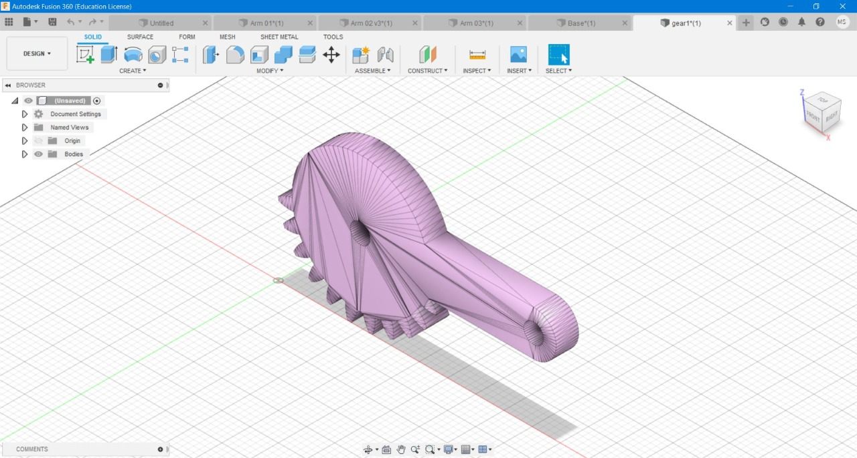
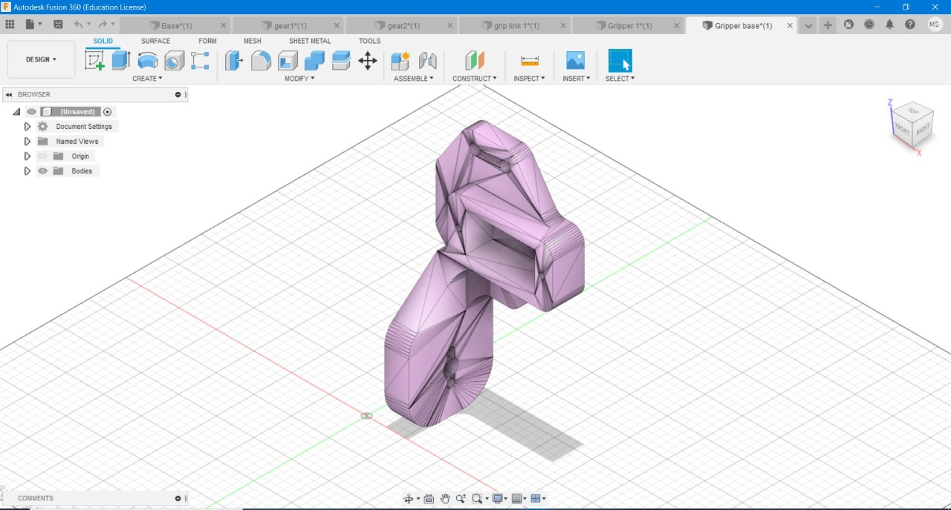
3D Modelling : done using FUSION 360

Slide 17
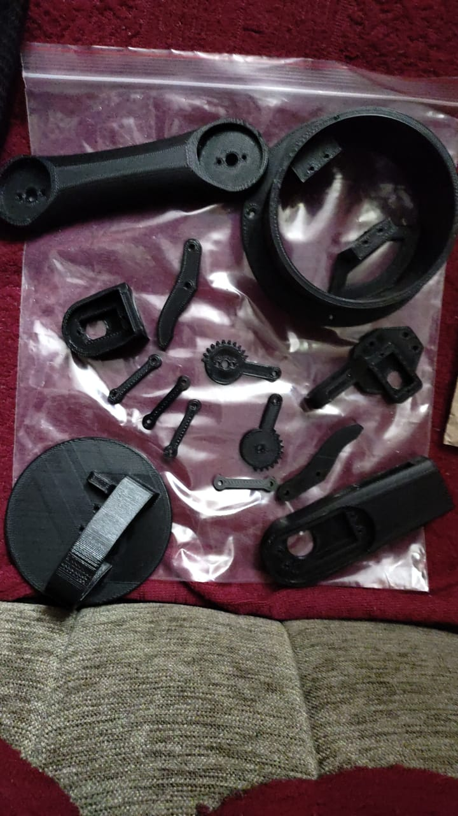
3D printed parts

Slide 18
PHOTOS AND VIDEOS :

Slide 19
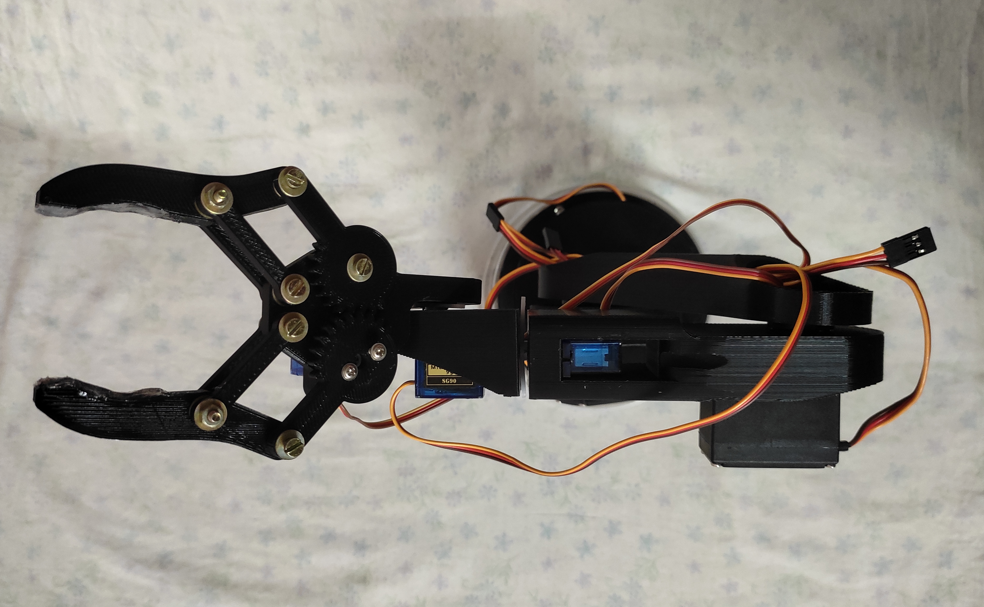

Slide 20
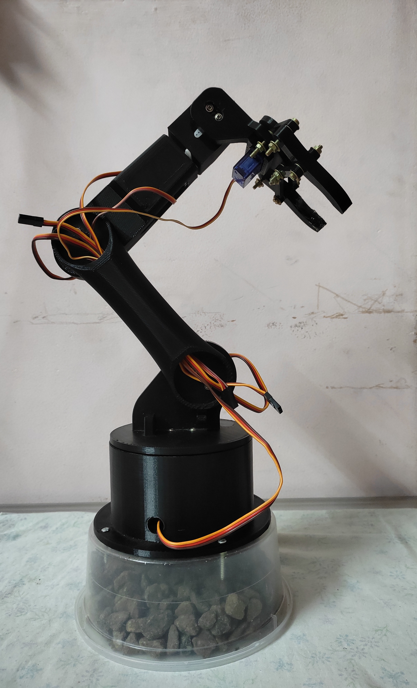

Slide 21
Link for video – SCARAN DOF :
https://drive.google.com/file/d/1Rs0Vo69NuCyeZw27jOoBYG4NOPHB8dDe/view?usp=sharing
Link for video - SCARAN picking object :
https://drive.google.com/file/d/1Y-1Hgb8N0SQkThnrv_WV9Qim7fIJIizT/view?usp=sharing

